Slide 1
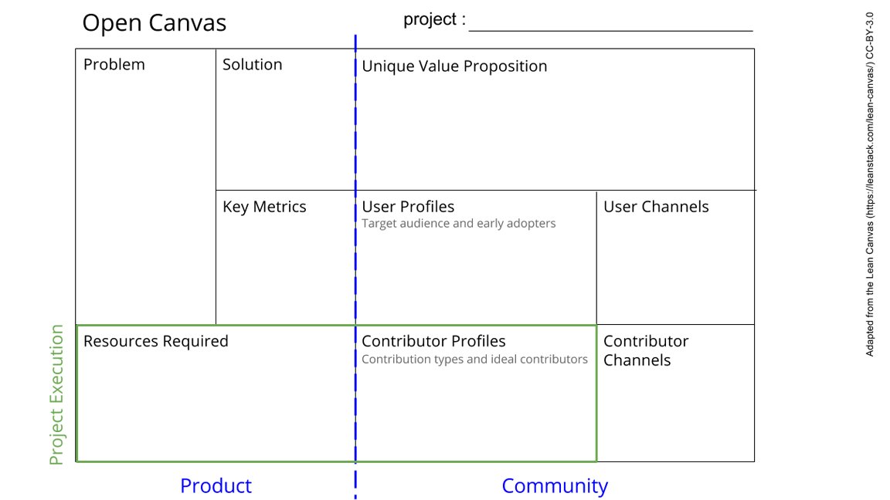
Truth Navigation: Empowering Equity-Seeking Groups through Digital Research Infrastructure with Automated Fake News Detection Case Study
Misinformation Spread: Equity-seeking groups often lack the tools and knowledge to effectively identify and combat fake news on social media.
Limited Access to DRI due to a lack of awareness and resources.
Training Programs
Resource Development.
Community Engagement. and support.
Mentorship Programs.
Empowerment through Education: Empower equity-seeking groups with the knowledge and tools to navigate and utilize DRI effectively.
Inclusive Research Environment: Foster an inclusive research environment where all individuals have access to advanced digital tools and technologies.
#workshops conducted.
Participant feedback and satisfaction scores.
Improved understanding of explainable AI among participants.
Post-workshop implementation of detection systems by stakeholders.
- Workshops.
- Educational Institutions
- Immigrants centers
- Government Agencies
- Social Workers around the city
Equity-seeking groups including Newcomers and Refugees, Women, Indigenous ppl, Women, 2SLGBTQQIA+, ppl with disability.
High-Performance Computing (HPC) Resources.
Data Management Services.
Training Materials.
Collaborative Platforms.
Financial Support.
Expertise and Mentorship.
(1) Volunteers: Lived experiences, community insights, and feedback, (2) Tech Industry Experts: Technical resources, infrastructure, (3)Educators/guest speaker: Teaching, mentorship, knowledge sharing,
(4)Community Organization Leaders: insights reg. challenges faced by their communities, co-organizing workshops, and ensuring effective outreach
- Fellow researchers - Graduate students in cybersecurity
- Non-Governmental Organizations
- Digital Research Alliance of Canada (Compute Canada)
Notes:
Go to File > Make a Copy… to make your own canvas
See next slide for instructions

